Slide 1
Fault Tolerance in DS
DS should be designed or construct in such way that it will automatically recover from partial failures, without seriously affecting the overall performance.
A DS must should always tolerate the fault.
Fault tolerant system is dependent system on 4 points:
Availability: system is available and ready to use at given time./immediately
Reliability: for a given time, system runs continuously without failure.
Highly reliable system works for a longer interval of time without interruption.

Slide 2
Safety: if for a some time ( temporary) system fails . In this case system doesn’t have major loss
Repairibility: how easy to repair the failed system
Note:
A Fault Tolerant system can provide services
even in presence of faults.

Slide 3
Process Resilience
Process resilience totally dependent on fault and failure.
Fault: incorrect state (something bad happen)in a system. Database slowdown, memory leaks, bad data.
Failure: inability of system to do its intended job.
Resilience: it is about preventing fault turning into failure.(fault slowly converts into system failure)

Slide 4
To make process fault tolerance by arranging to have a group of processes with each member of group being identical.
Question: I want some data. Multiple servers near me.data is much important and don’t want to loose that data. What to do?
you can store data in multiple copies in all servers (replication)that reduces fault tolerance.
Request message for data sends to all servers (group members)and whoever first taking request will reply you.
If any one process or server fails ,it is assumed that another process still be able to do the functionality to provide the service.

Slide 5
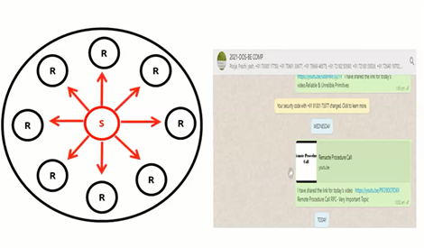
Group communication
When one source process tries to communicate with multiple processes at once, it is called Group Communication.
Group communication is the act of sending and receiving messages to multiple members of a group.

Slide 6
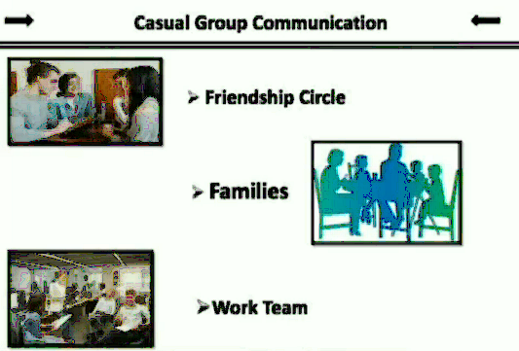

Slide 7
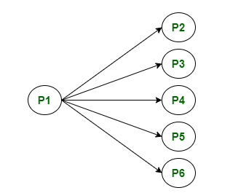
Broadcast Communication :
When the host process tries to communicate with every process in a distributed system at same time.
Broadcast communication comes in handy when a common stream of information is to be delivered to each and every process in most efficient manner possible.

Slide 8
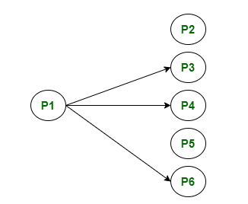
Multicast Communication
When the host process tries to communicate with a designated group of processes in a distributed system at the same time.

Slide 9
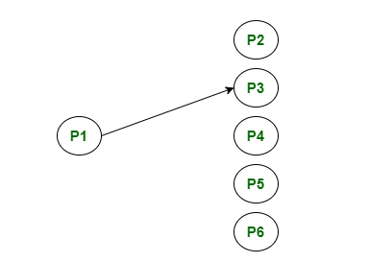
Unicast Communication
When the host process tries to communicate with a single process in a distributed system at the same time.

